Slide 1
AngularJS SPA

Slide 2
Why use it?
The problem – HTML is great for static pages, but has no tools for web applications
The solution – extend and adapt HTML vocabulary with some additional declarations that are useful for web applications

Slide 3
Angular JS facts
Open-source JavaScript framework
Developed in 2009 by Miško Hevery and Adam Abrons
Maintained by Google
Actively developed and supported

Slide 4
AngularJS is a structural framework for dynamic web applications. It lets you use HTML as your template language and lets you extend HTML's syntax to express your application components clearly and succinctly. Its data binding and dependency injection eliminate much of the code you currently have to write. And it all happens within the browser, making it an ideal partner with any server technology.

Slide 5
General Features
AngularJS is a efficient framework that can create Rich Internet Applications (RIA).
AngularJS provides developers an options to write client side applications using JavaScript in a clean Model View Controller (MVC) way.
Applications written in AngularJS are cross-browser compliant. AngularJS automatically handles JavaScript code suitable for each browser.
AngularJS is open source, completely free, and used by thousands of developers around the world. It is licensed under the Apache license version 2.0.

Slide 6
Disadvantages
Not secure
Not degradable

Slide 7
Agenda
AngularJS Features
Getting Started
Directives, Filters and Data Binding
Views, Controllers and Scope
Modules, Routes and Factories

Slide 8
AngularJS Directives
ng-app : This directive defines and links an AngularJS application to HTML.
ng-model : This directive binds the values of AngularJS application data to HTML input controls.
ng-bind : This directive binds the AngularJS application data to HTML tags.

Slide 9
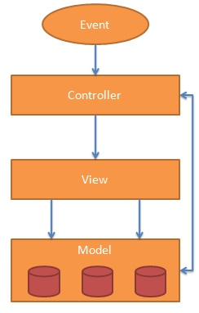
MVC Architecture

Slide 10
Using Directives and Data Binding
Directive
<!DOCTYPE html>
<html ng-app>
<head>
<title></title>
</head>
<body>
<div class="container">
Name: <input type="text" ng-model="name" /> {{ name }}
</div>
<script src="Scripts/angular.js"></script>
</body>
</html>
Directive
Data Binding Expression

Slide 11
Iterating with the ng-repeat Directive
<html data-ng-app="">
...
<div class="container" data-ng-init="names=['Dave','Napur','Heedy','Shriva']">
<h3>Looping with the ng-repeat Directive</h3>
<ul>
<li data-ng-repeat="name in names">{{ name }}</li>
</ul>
</div>
...
</html>
Iterate through names

Slide 12
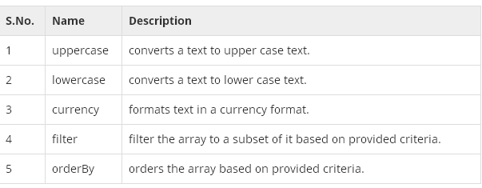
AngularJS - Filters

Slide 13
Using Filters
<ul>
<li data-ng-repeat="cust in customers | orderBy:'name'"> {{ cust.name | uppercase }} </li>
</ul>
Order customers by name property
Filter customers by model value
<input type="text" data-ng-model="nameText" />
<ul>
<li data-ng-repeat="cust in customers | filter:nameText | orderBy:'name'"> {{ cust.name }} - {{ cust.city }}</li>
</ul>

Slide 14
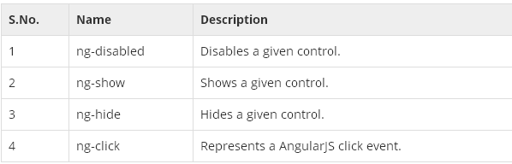
AngularJS - HTML DOM

Slide 15
Events
ng-click
ng-dbl-click
ng-mousedown
ng-mouseup
ng-mouseenter
ng-mouseleave
ng-mousemove
ng-mouseover
ng-keydown
ng-keyup
ng-keypress
ng-change

Slide 16
AngularJS - Includes
HTML does not support embedding HTML pages within the HTML page.
Using Ajax - Make a server call to get the corresponding HTML page and set it in the innerHTML of HTML control.
Using Server Side Includes - JSP, PHP and other web side server technologies can include HTML pages within a dynamic page.

Slide 17
AngularJS - Views
ng-view Directive
ng-template Directive
$routeProvider Service

Slide 18
AngularJS - Dependency Injection
Dependency Injection is a software design in which components are given their dependencies instead of hard coding them within the component.

Slide 19
Components
Value
Factory
Service
Provider
Constant

Slide 20
AngularJS – Internalization
(Localization)
Currency, Date, and Numbers.

Slide 21
